Slide 1


TST Workgroup Updates- Year 4
Clearwater, FL
October 14th, 2019

Slide 2
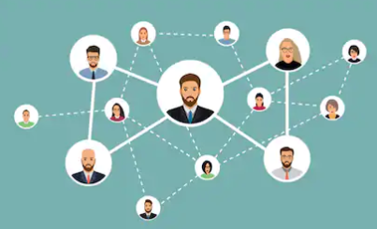
Technology
Feasibility Study- PCG conducted over several months 2019
NE- KS- TN review
Project evolved from referral tool to recruitment tool and referral tool with electronic COE capabilities
August received the notification from PCG about costs and steps moving forward. Cost was way too much for IRRC going forward. $99,000 minimum for pilot states and then comparable costs going forward for each state each year.

Slide 3

Technology Project
Workgroup met- decision was made to seek other vendors or work to do project in house
Project was defined as a referral gathering tool instead of a recruitment tool specifically focused on electronic COEs.
This was unanimously decided by the group.
More vendors were sought.

Slide 4

Technology
In September we received three proposals from three vendors- MIS2000, QuickBase, Dana Johnson. The group reviewed the three and determined the best choice.
The project was then started by developer Dana Johnson.
This was to be completed by the end of October.
It is a electronic referral tool. We will be working on roll out of this with you all.

Slide 5
Technology- Referral Tool
Universal link where anyone can make a referral
Once a referral is made and one or two yes responses are noted the referral is assigned to a recruiter who then contacts them and reports back if they were eligible.
State Administrator can assign new roles, and who gets what referral based on location of the referral.
IRRC Admin can assign roles, help states, and recruiters.

Slide 6
Technology- Pilot
Sample found here: https://irrc.greengoblin.com/index.php
https://irrc.greengoblin.com/admin
How many people per state would you like to pilot the system?
How will states promote the system?
Need to determine a date we all get on and put in lots of referrals to determine how much the system can take.
What other languages do we want to be included?

Slide 7
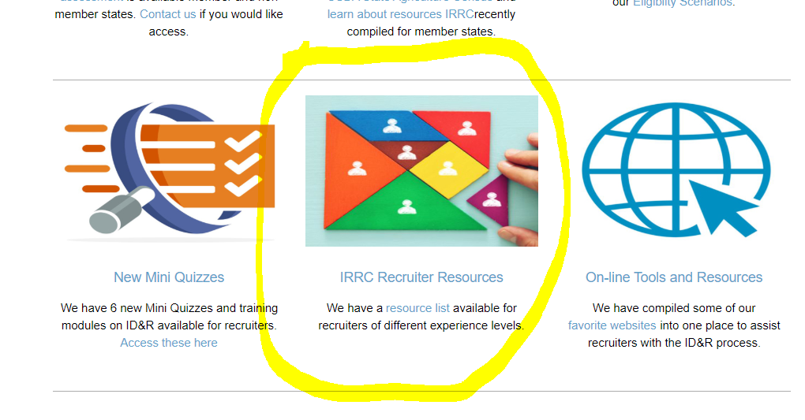
Professional Development
Originally idea was to make some videos that would break down different elements of ID&R and be for veteran and novice recruiters.
This idea was changed to look specifically at the areas of ID&R and what resources we had already and to put them in one place with a listing of all of those resources broken down by novice and veteran recruiters. https://www.idr-consortium.net/ID&RNovice.html

Slide 8

Professional Development
Then we worked to put all of the mini quizzes into electronic form so new and veteran recruiters could take the tests and then see their results right away. https://www.idr-consortium.net/MiniQuizzes.html

Slide 9
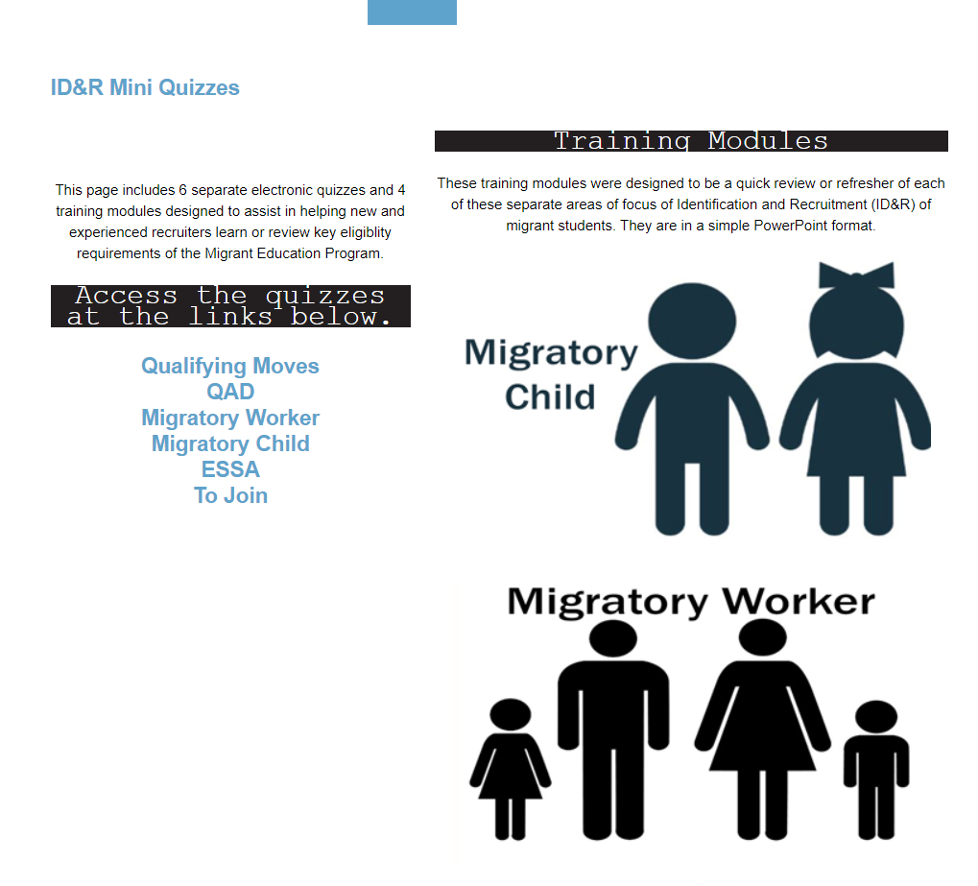
Professional Development

Slide 10
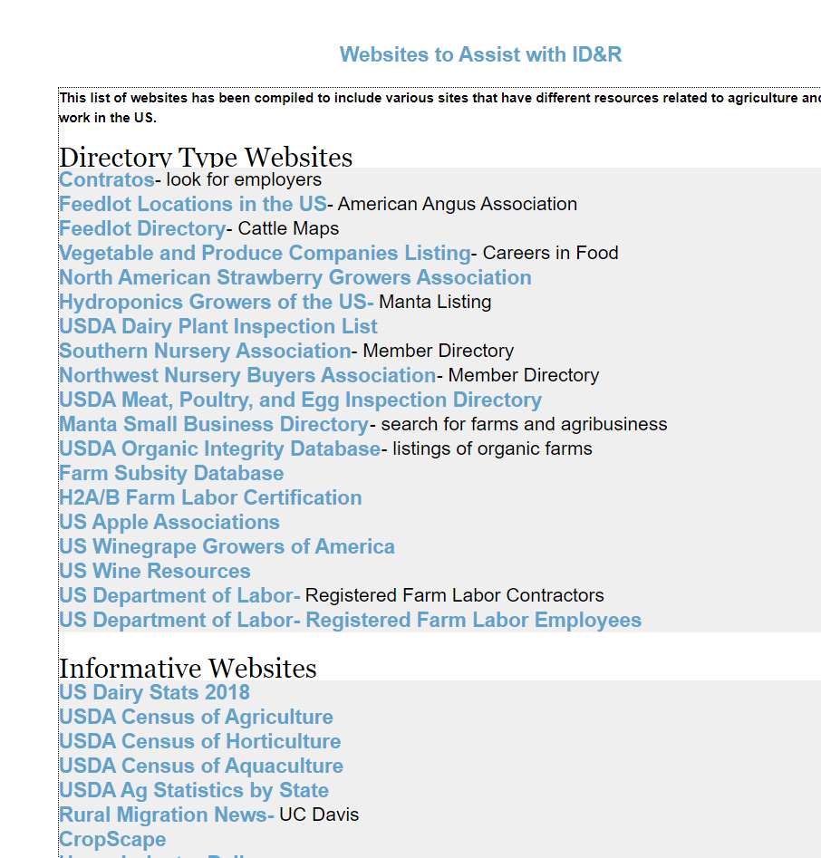
Professional Development
Also included on the site for novice and veteran recruiters is a listing we will be working on that includes good websites for recruiters. These are listed on the front page of the site. https://www.idr-consortium.net/Websites.html

Slide 11

Professional Development
This group also hosted the Ag Census Informational Webinars
https://www.idr-consortium.net/Knowing%20and%20Understanding%20the%20Ag%20Census.pdf

Slide 12
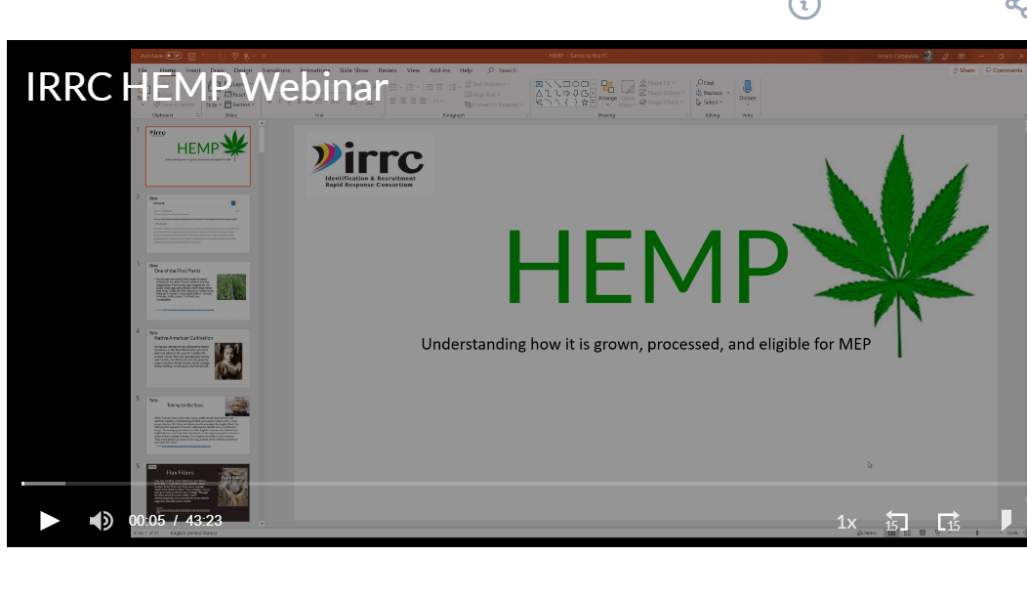
Professional Development
This group hosted the Hemp Informational Webinars
https://transcripts.gotomeeting.com/?utm_source=recordingReadyNotification&utm_medium=email#/s/2ca10235ce14e27eb9268ef49b70aa36a7f6d16e57ad5e3456e7a1e341f2ccfd

Slide 13
TRI
Conducted TRI Visits in many states- Iowa, Delaware, SC, Tennessee, NY, and more
Some of these were visits focused on ID&R others were to assist with re-interviews.
A couple of them were backed with funding from IRRC plus state funding, some were specifically employee trades from one state to another.
Want focus of Year 5 to include more ID&R training as needed.
Created list of experienced ID&R mentors- we have 25. What do you want done with this list?

Slide 14
Dissemination / Website
Worked on the Ag Census Projects for each state
These have all be compiled https://www.idr-consortium.net/AgCensus.html
Worked on electronic versions of Mini Quizzes and put online on the Classmarker site
Ag Trends newsletters, updates, and emails

